Slide 1
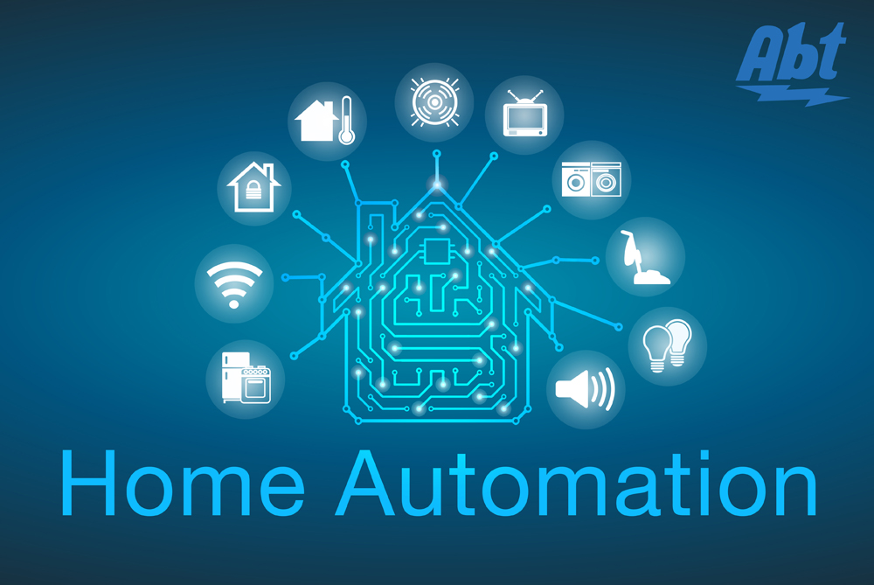
WIFI BASED HOME AUTOMATION
SMART
HOME
Presented by:
Sandip Das Pradhan
Tanmoy Jana
Sourav Giri
Chiranjit Bhunia
WI-FI CONTROL

Slide 2
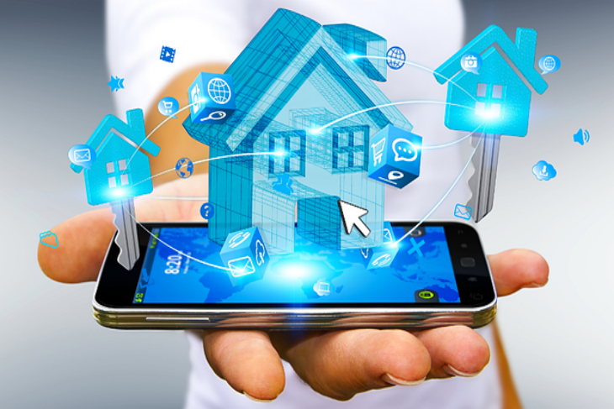
INDEX
INTRODUCTION
BLOCK DIAGRAM
HARDWARE REQUIRED
HARDWARE DETAILS
SOFTWARE AND APP USED
SOFTWARE AND APP DETAILS
ADVANTAGES
DISADVANTAGES
FUTURE SCOPE
REFERENCES

Slide 3
INTRODUCTION
SMART HOME
To develop a WIFI based home automation system with Node-MCU Board and an Android application.
Remote controlled home automation system provides a simpler solution with Android application technology.
Remote operation is achieved by any smart phone/Tablet etc., with Android OS, upon a GUI(Graphical User Interface) based touch screen operation.

Slide 4
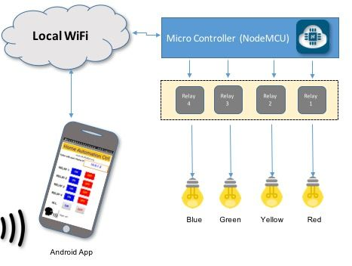
BLOCK DIAGRAM
SMART HOME

Slide 5
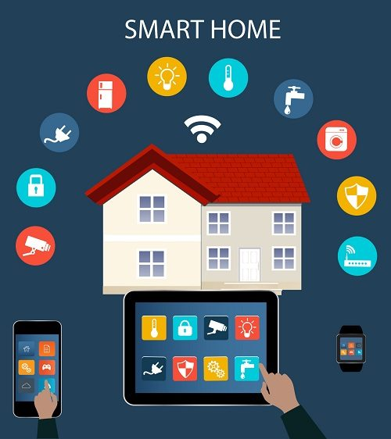
HARDWARE REQUIREMENTS
SMART HOME
Node MCU
4 channel 5V Relay
5 v charger
Table Fan
220V LED Bulb
Male Female Wire

Slide 6
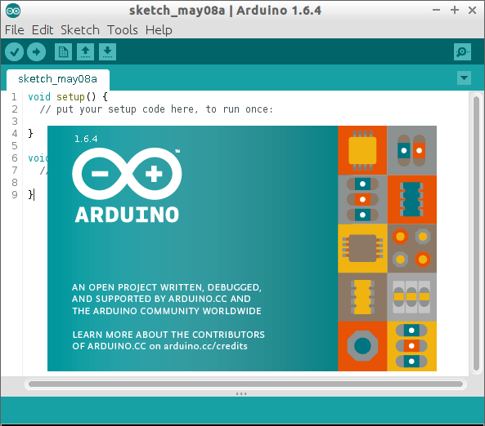
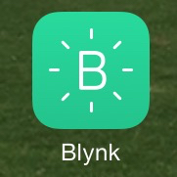
SOFTWARE REQUIREMENTS
SMART HOME
Arduino IDE
Blynk android application

Slide 7
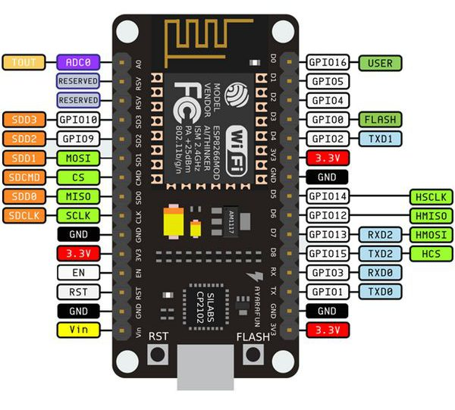
Node-MCU Specification:
SMART HOME
Developer : ESP8266 Opensource Community
Type : Single-board microcontroller
Operating system : XTOS
CPU : ESP8266
Memory : 128kBytes
Storage : 4MBytes
Power By : USB
Power Voltage : 3v ,5v (used with 3.3v Regulator which inbuilt on Board using Pin VIN)
Code : Arduino Cpp
IDE Used : Arduino IDE
GPIO : 10

Slide 8
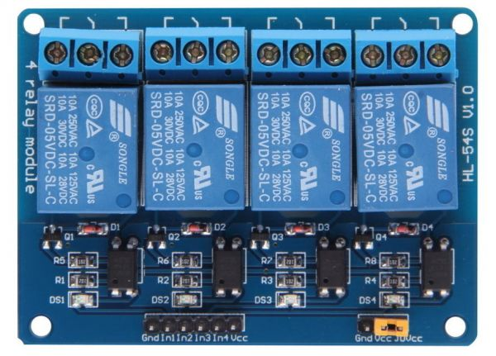
RELAY MODULE
SMART HOME
Relay is basically an electromagnetic switch which can be turn ON and OFF by applying the voltage across its contacts.
In this project we used a 12V 5 pin relay.

Slide 9
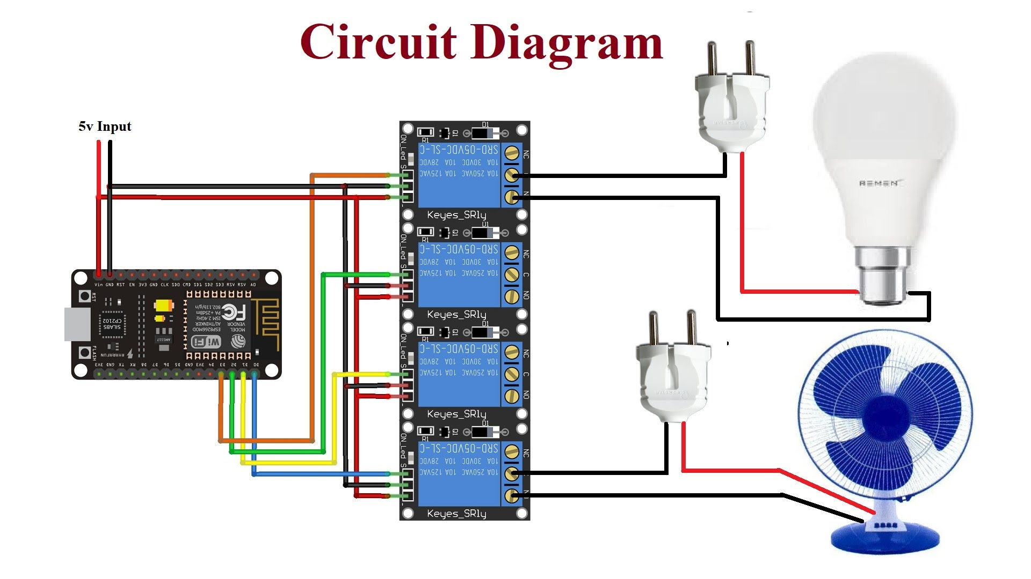
CIRCUIT DIAGRAM

Slide 10
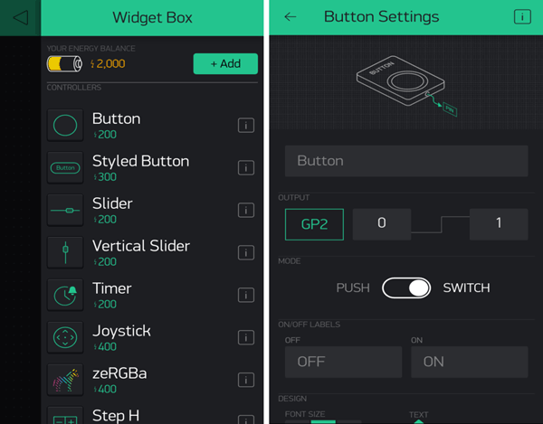
Android Application Use
SMART HOME
Blynk App: Blynk was designed for the Internet of Things. It can control hardware remotely, it can display sensor data, it can store data, vizualize it and do many other cool things.

Slide 11
CONSTRUCTION AND WORKING
SMART HOME
1. Plug in the board and upload the program
2. While uploading the program do not forgot to put correct SSID and Wi-fi name
3. Upload and wait for a while , till the sensor is stable and then open the com port , you will see the status , that Blynk is connected to the internet
4. Once it is confirmed, then unplug the device from the PC and power it up an 5V Dc source and enjoy controlling your home appliances

Slide 12
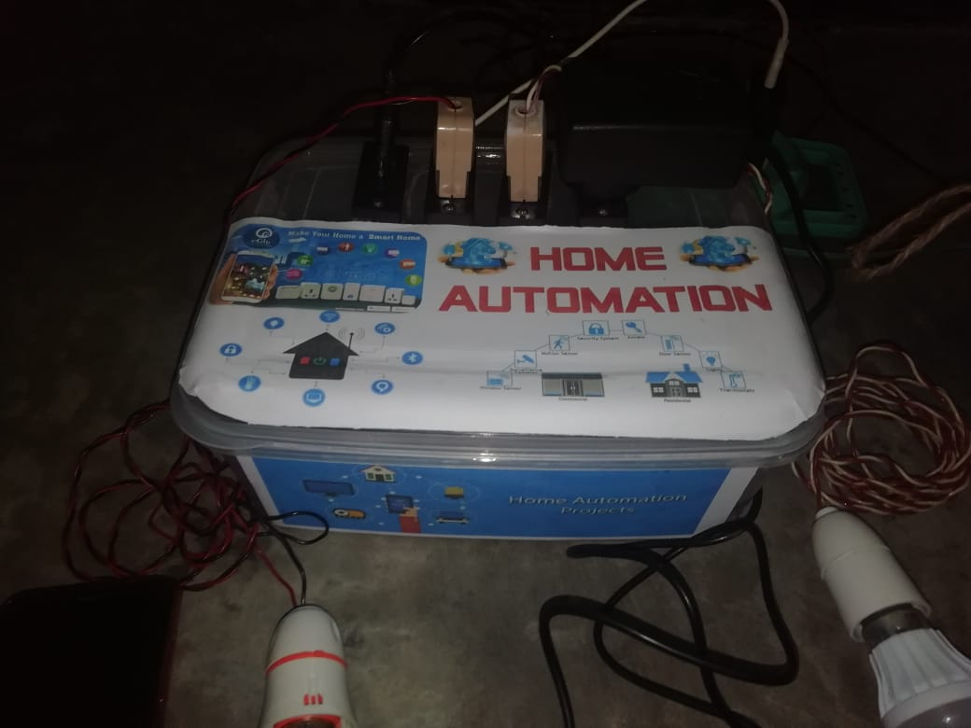
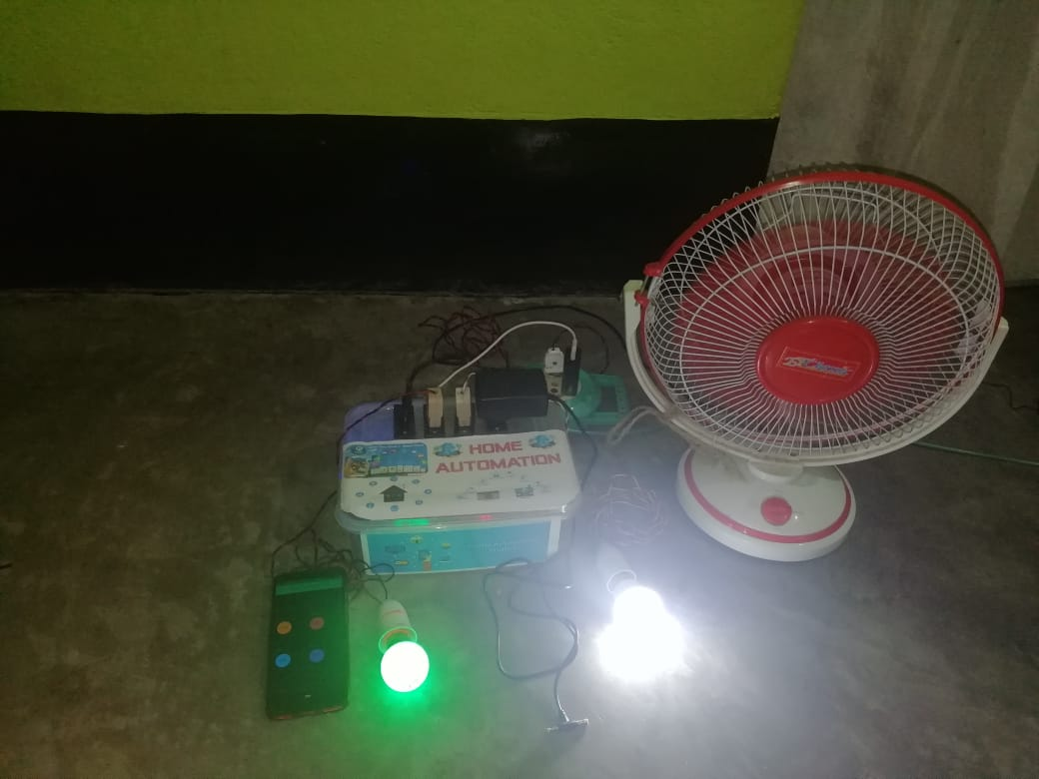
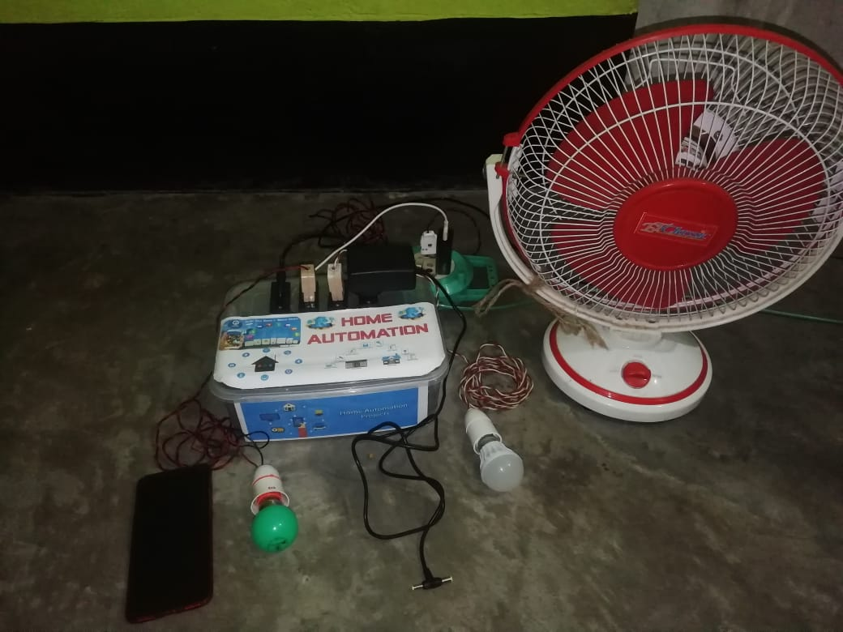
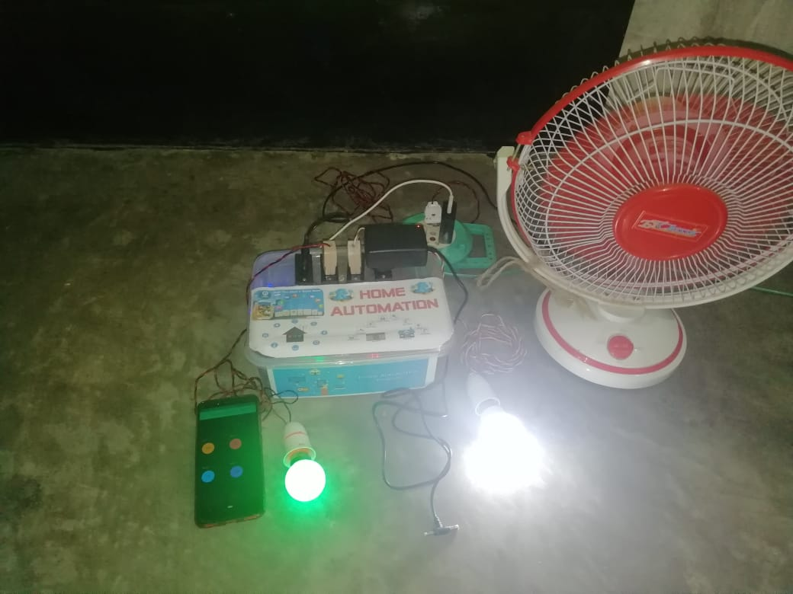
RESULTS
SMART HOME
Before Sending Massage
After Sending Massage

Slide 13
Advantage
SMART HOME
Safety. The ability to control small appliances and lighting with your fingertips anywhere you are will add safety in your home. You can make sure appliances are off when its needed to be off and on when its needed to be on.
Security. The ability to lock the door through your phone is one of the greatest benefits of home automation. This will give you peace of mind knowing that the door is close and not guessing. The fact that you can be alerted each time someone enters your home also allows you to monitor who is entering your home at all times, especially when you are not there.
Convenience. The ability to control everything with your fingertips is very convenient. You never leave the house without your wallet, keys and your smart phone. With our smart phone always with us, we can easily monitor our home and control everything with just touch of a finger.
Saves Time. Since we are living in a very fast-paced environment, we don’t even have time to worry about our home. With home automation, we can save time going back to our home and make sure everything is order, like if the kids close the door from school or turn on the lights when you get home.
Save Money. This is the biggest advantage of home automation. With the ability to control the light, whether dimming or turning on/off on specific time will saves homeowner a great ton of money. You can save money through household temperature, with proper automation in window shades and automated thermostat. In addition, you can save gas, by not driving back home if you forgot to turn off appliances or lock the door.

Slide 14
Limitations
SMART HOME
The system needs a continuous power supply to be practical or else we might not be able to control the appliances.
Hence, best way to design the system efficiently would be to implement both the automated control and manual control through switches at a time.

Slide 15
User Friendly Graph
SMART HOME

Slide 16
Conclusion
SMART HOME
This paper proposes a low cost, secure, ubiquitously accessible, auto-configurable, remotely controlled solution. The approach discussed in the paper is novel and has achieved the target to control home appliances remotely using the Wi-Fi technology to connects system parts, satisfying user needs and requirements. Wi-Fi technology capable solution has proved to be controlled remotely, provide home security and is cost-effective as compared to the previously existing systems. Finally, the proposed system is better from the scalability and flexibility point of view than the commercially available home automation systems.

Slide 17
Future work
SMART HOME
More intelligent should be added to hardware modules to make them capable to take decision according to triggered alarms. Without referring to server for each event and action. That will increase the response time of the system. While hardware interface module reports server with events and actions on pre-programmed intervals.
Replace the WiFly WiFi module with more reliable and stable WiFi module, to increase system reliability.
Implements more hardware interface modules, and modify server application software to handle them.

Slide 18
reference
SMART HOME
Christian Reinisch ,“Wireless Communication in Home and Building Automation”, Master thesis, Viennia univeristy of technology
http://wiki.smarthome.com/index.php?title=Home_Automation
A.J. Bernheim Brush, Bongshin Lee, Ratul Mahajan, Sharad Agarwal, Stefan Saroiu, and Colin Dixon, "Home Automation in the Wild
https://www.roboshala.com/wifi-home-automation/

Slide 19
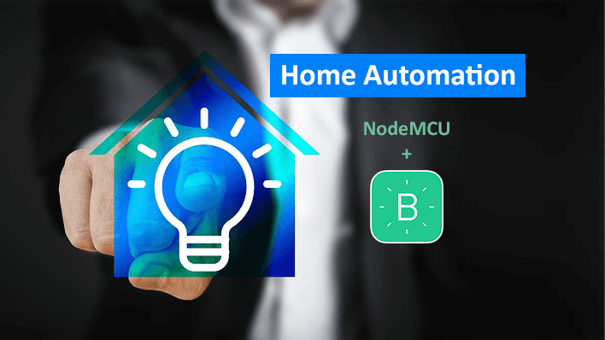

SMART
HOME
WI-FI CONTROL

